Slide 1
AUTOMATIC NUMBER PLATE RECOGNITION

Slide 2
INTRODUCTION
Automatic number-plate recognition is a technology that uses optical character recognition on images to read vehicle registration plates to create vehicle location data.It can be used to store the images captured by the cameras as well as the text from the license plate

Slide 3
ADVANTAGES AND USES
Vehicle Parking (commercial or resedential area)
Toll Gates
Vehical Survelliance (used by police to detect vehicals)
Traffic control Department.
Enhanced parking management
Faster Traffic Management.
Better security and prevention of crimes like car thefts
Provides better evidence and lines of inquiry
Automates access control systems
Allows modern and effective law enforcement

Slide 4
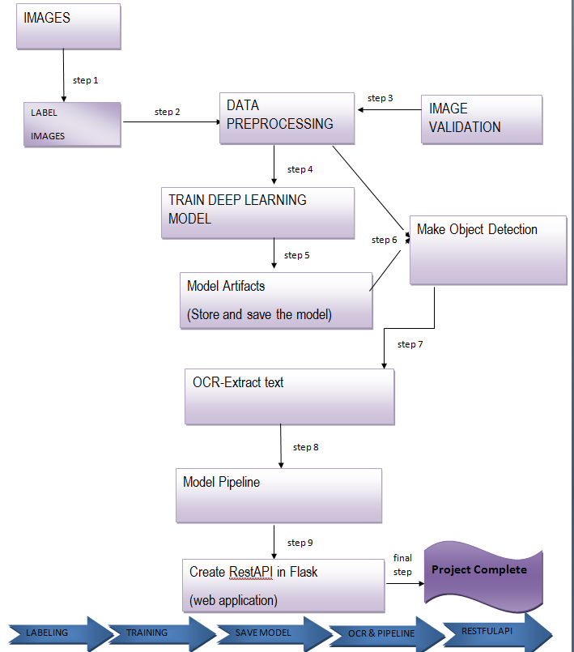
PROJECT ARCITECTURE

Slide 5
Software used
Anaconda
Jupyter notebook
Command prompt
Visual studio code
Tesseract
PyTesseract
YOLO

Slide 6
CORE CONCEPT
Scanning the image and extract text from it and reading text
Upload a vehicle image creates a bounding box on number plate ,cropping the number plate and extracting text from it.

Slide 7
What is bounding box?
Bounding boxes are rectangles that mark objects on an image. There are multiple formats of bounding boxes annotations The bounding box has the following (x, y) coordinates of its corners: top-left is (x_min, y_min) or (98px, 345px), top-right is (x_max, y_min) or (420px, 345px), bottom-left is (x_min, y_max) or (98px, 462px), bottom-right is (x_max, y_max) or (420px, 462px). As you see, coordinates of the bounding box's corners are calculated with respect to the top-left corner of the image which has (x, y) coordinates (0, 0).

Slide 8
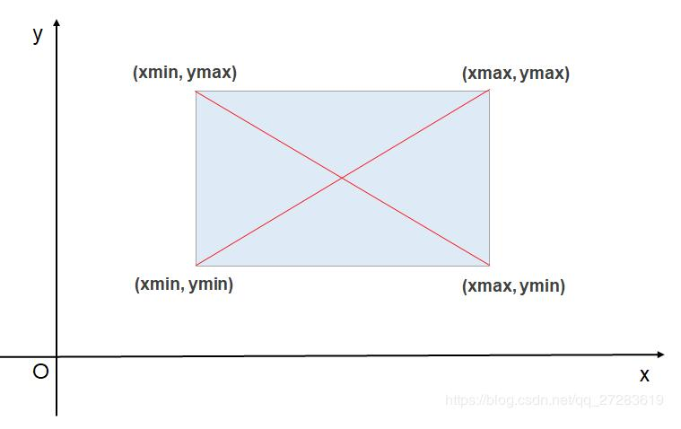
Bounding box

Slide 9
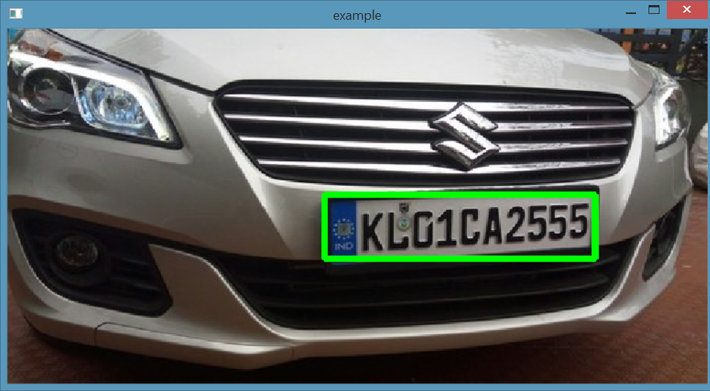
Bounding box on number plate

Slide 10
Model
YOLO is an abbreviation for the term ‘You Only Look Once’. This is an algorithm that detects and recognizes various objects in a picture (in real-time). Object detection in YOLO is done as a regression problem and provides the class probabilities of the detected images.
The YOLO algorithm consists of various variants. Some of the common ones include tiny YOLO and YOLOv5.

Slide 11
Why the YOLO algorithm is important
YOLO algorithm is important because of the following reasons:
Speed: This algorithm improves the speed of detection because it can predict objects in real-time.
High accuracy: YOLO is a predictive technique that provides accurate results with minimal background errors.
Learning capabilities: The algorithm has excellent learning capabilities that enable it to learn the representations of objects and apply them in object detection.

Slide 12
OCR
Optical Character Recognition. In other words, OCR systems transform a two-dimensional image of text, that could contain machine printed or handwritten text from its image representation into machine-readable text. OCR as a process generally consists of several sub-processes to perform as accurately as possible.

Slide 13
TESSERACT AND PyTESSERACT
Tesseract — is an optical character recognition engine with open-source code, this is the most popular and qualitative OCR-library.OCR uses artificial intelligence for text search and its recognition on images.
Pytesseract is a wrapper for Tesseract-OCR Engine. It is also useful as a stand-alone invocation script to tesseract, as it can read all image types supported by the Pillow and Leptonica imaging libraries, including jpeg, png, gif, bmp, tiff, and others.
Installing tesserct and pytesseract

Slide 14
Tesseract limitations summed in the list
The OCR is not as accurate as some commercial solutions available to us.
Doesn't do well with images affected by artifacts including partial occlusion, distorted perspective, and complex background.
It is not capable of recognizing handwriting.
It may find gibberish and report this as OCR output.
If a document contains languages outside of those given in the -l LANG arguments, results may be poor.
It is not always good at analyzing the natural reading order of documents. For example, it may fail to recognize that a document contains two columns, and may try to join text across columns.
Poor quality scans may produce poor quality OCR.
It does not expose information about what font family text belongs to.

Slide 15
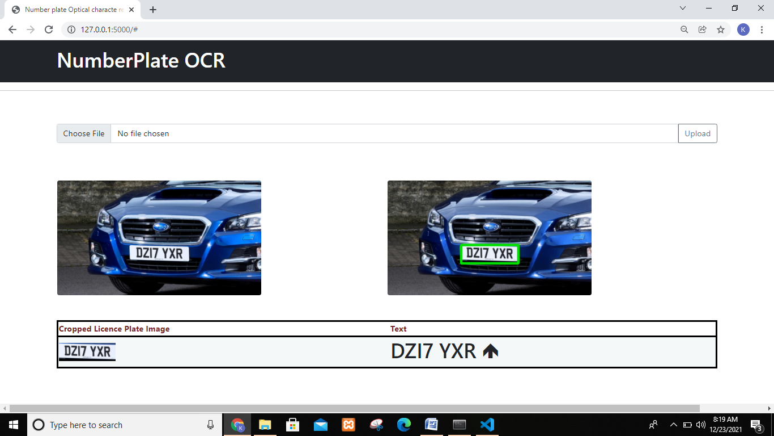
FINAL APP

